Slide 1
Dave Bartlett | Medhurst Storage Migration Service 2019 Bitlocker Update
Microsoft TVP 2018

Slide 2
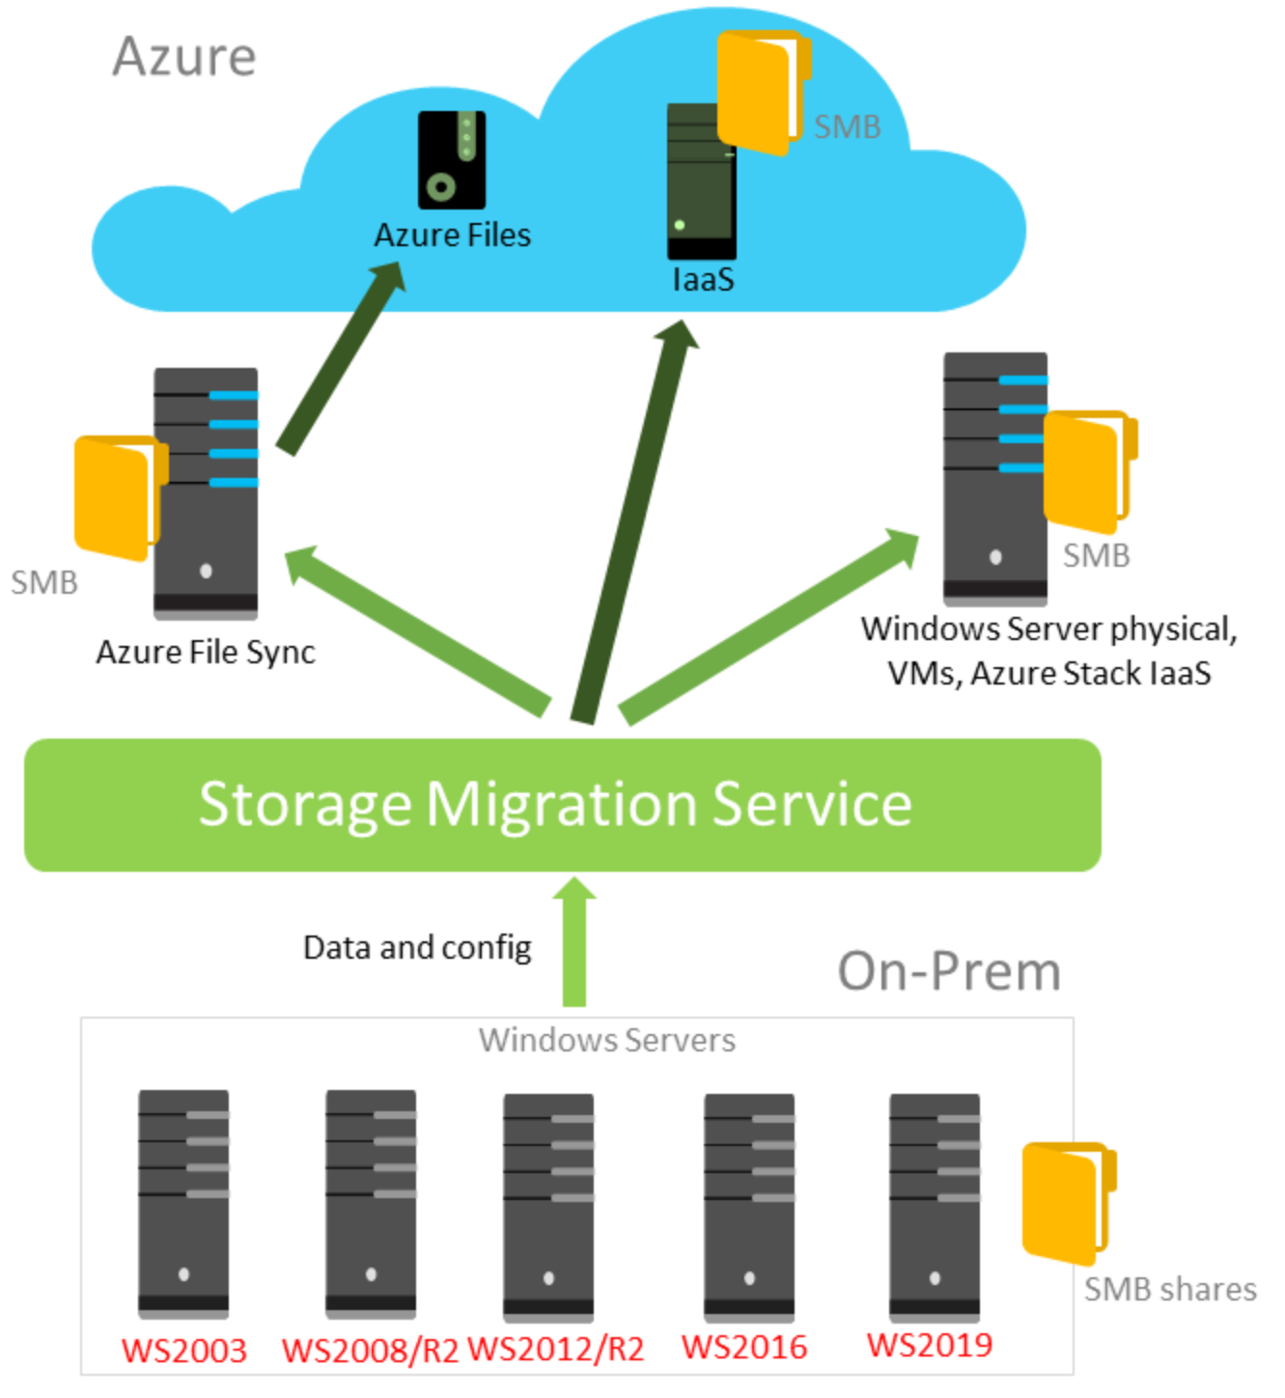
Server 2019 | Storage Migration Service
“Simplifies the migration of file servers using an orchestrated process”
Moves data from multiple sources to target servers and then performs a cut-over process.
Requirements
Supports Server 2003 upwards as a source file server
Supports Server 2012 R2 upwards as a destination file server
Requires Server 2019 for the Orchestrator Service

Slide 3
BitLocker Update | Deployment
Can be deployed through System Center Configuration Manager, MDT or Intune
Does not require TPM hardware but is highly recommended
Stores information in Active Directory (2008 R2 Schema required)
Enhanced Pin allows alphanumeric characters
Group Policy to provide removable media protection
Enable Active Directory Recycle Bin!

Slide 4
Handy Links
Storage Migration Service overview
https://docs.microsoft.com/en-us/windows-server/storage/storage-migration-service/overview
Planning for an Azure File Sync deployment
https://docs.microsoft.com/en-us/azure/storage/files/storage-sync-files-planning

Slide 5
Many thanks for listening.

